Slide 1
Basic Tree Appraisal
Focusing on the Trunk Formula Technique
Terrence P. Flanagan
BCMA #PN-0120BMTL
James Komen
BCMA #WE-9909B
RCA #555
March 7, 2019

Slide 2
Speaker Introductions
Terrence P. Flanagan
Member of ASCA TPAQ Committee
Past president and board member of ISA
Chair of the panel of experts for TRAQ
Past President and board member of PNW-ISA
Board Certified Master Arborist (BCMA)
James Komen
Registered Consulting Arborist (RCA) and Board Certified Master Arborist (BCMA)
Author of articles and studies regarding appraisal published in ISA Arborist News, Western Chapter Newsletter, ASCA Newsletter.

Slide 3
James’ Papers
Studies on Appraisal
An Analysis of the Field Precision of the CTLA Trunk Formula Method, Arboriculture & Urban Forestry 2015. 41(5): 279–285
Inter-Appraiser Variability for Written Appraisals as published by Western Arborist 2017 Winter
Field Precision of Collaborative-Appraisal Using CTLA Trunk Formula Method as published by Western Arborist
The Importance of Tree Appraisal as published by TCIA Magazine June 2016 / Response Letters as published by TCIA Magazine August 2016
Critical Analysis of the ATA Formula as published by Western Arborist
Full article text at: www.jameskomen.com/articles-and-research.php

Slide 4
Author of Presentation
James Komen
Has studied appraisal from a practical viewpoint
Interested in making sure that people understand the process and understand the need to defend the necessary decisions
Created a presentation that:
Explains the basics of appraisal
Builds understanding of the basics
Starts to points out the strengths and weaknesses of different approaches

Slide 5
Housekeeping
Turn off Cell Phones
Restrooms
Respect your Peers’ Opinions

Slide 6
Workshop Outline and Goal
Cover the basic theory of Tree Appraisal
Give you the opportunity to practice on real trees
Brief over view of changes in current edition of the Guide for Plant Appraisal, 10th Edition, 2018

Slide 7
Tree Appraisal
Trees Have Value
Appraisal is an Opinion of Value
Reasons for Appraisal
Disputes/Litigation
Inventory/Management
Insurance
Construction Bonding
Municipal Fines
Others…?

Slide 8
Ethics in Appraisal
Must remain objective
Appraisals with the same assignment should remain the same regardless of the client or side
Avoid boosting or suppressing value to support a side
“Bought yourself a bigger tree.”
“Massaging numbers”
Revisions of substance
“I would be happy to correct mistakes, but not to change facts and/or my opinion.”

Slide 9
The Guide to Plant Appraisal
Council of Tree and Landscape Appraisers
ISA Regional Plant Appraisal Committees (RPACs)
Regional Species Classification Guides

Slide 10
The Guide to Plant Appraisal
Summary of Changes from 9th to 10th Edition (TFT)
New depreciation ratings
No Species Rating
No Adjusted Trunk Area (ATA)
Unit cost from LCATT to LCANT
Unit cost includes wholesale, not retail or installed cost
More flexibility with condition rating
More flexibility with rounding

Slide 11
Approaches to Appraisal
Market Approach
Direct Sales
Indirect Sales
Timber Sales
Income Approach
Present value of income generated by trees
Indirect Income – benefits of trees
Cost Approach

Slide 12
Approaches to Appraisal
Market Approach
Direct Sales
Indirect Sales
Timber Sales
Income Approach
Present value of income generated by trees
Indirect Income – benefits of trees
Cost Approach

Slide 13
Cost Approach
Cost vs. Value
What the tree costs is not necessarily what someone would pay for it
Okay if cost approach results in high appraisals

Slide 14
Cost Approach
Reproduction Cost Method
Direct Replacement
Used for smaller trees
Restricted to sizes actually available for sale
Extrapolation (Trunk Formula Technique)
Functional Replacement Method
Used in damage cases
Principle of Substitution
Cost of Repair

Slide 15
Cost Approach
Reproduction Cost Method
Direct Replacement
Used for smaller trees
Restricted to sizes actually available for sale
Extrapolation (Trunk Formula Technique)
Functional Replacement Method
Used in damage cases
Principle of Substitution
Cost of Repair

Slide 16
Trunk Formula Technique (TFT)
Why TFT?
Components of TFT
Trunk Cross Sectional Area
Unit Cost
Condition Rating
Functional Limitations Rating
External Limitations Rating

Slide 17
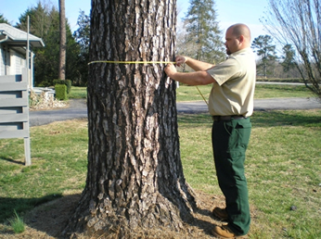
Purpose of this Workshop
Improve Precision
Calibrate our ratings
Reduce our error

Slide 18
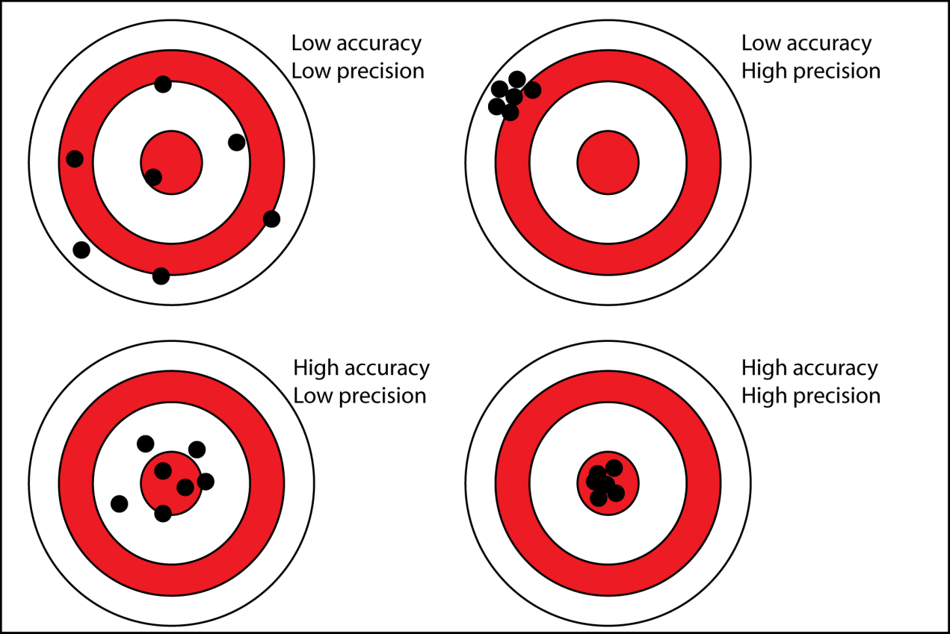
Accuracy vs. Precision

Slide 19
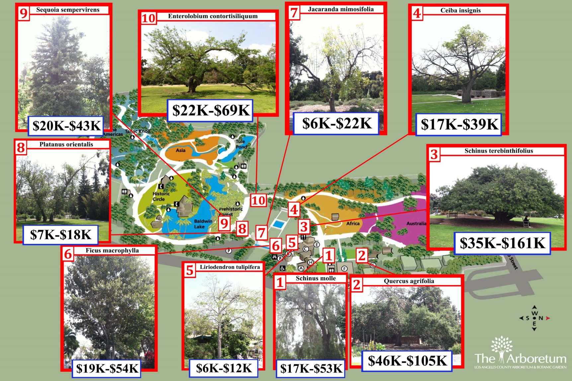
Precision in TFM (TFT)

Slide 20
Types of Error
Personal Observation Error
Personal Value Error
Measurement Error
Systematic Error

Slide 21
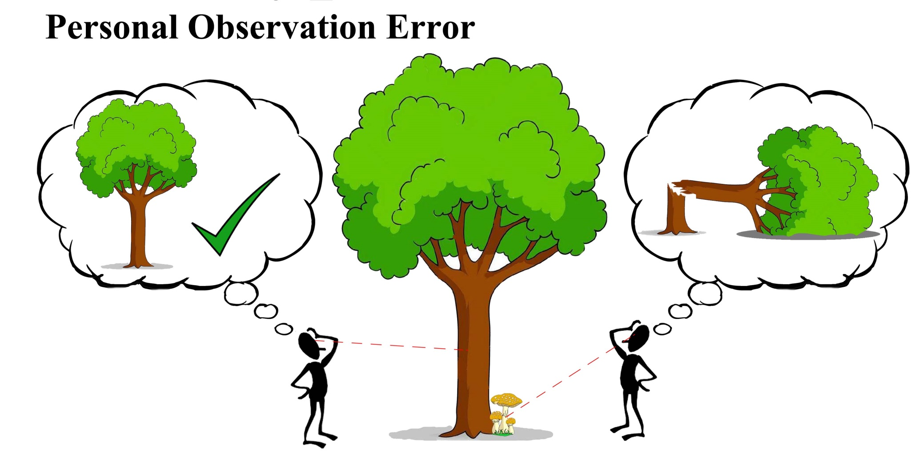
Types of Error

Slide 22
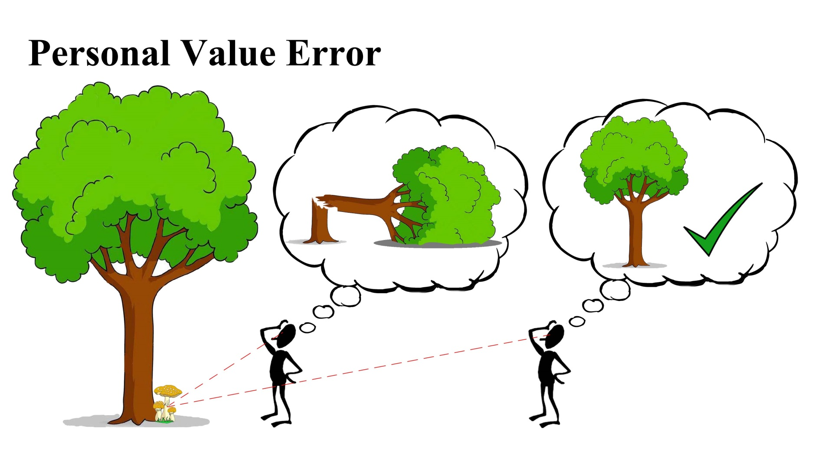
Types of Error

Slide 23
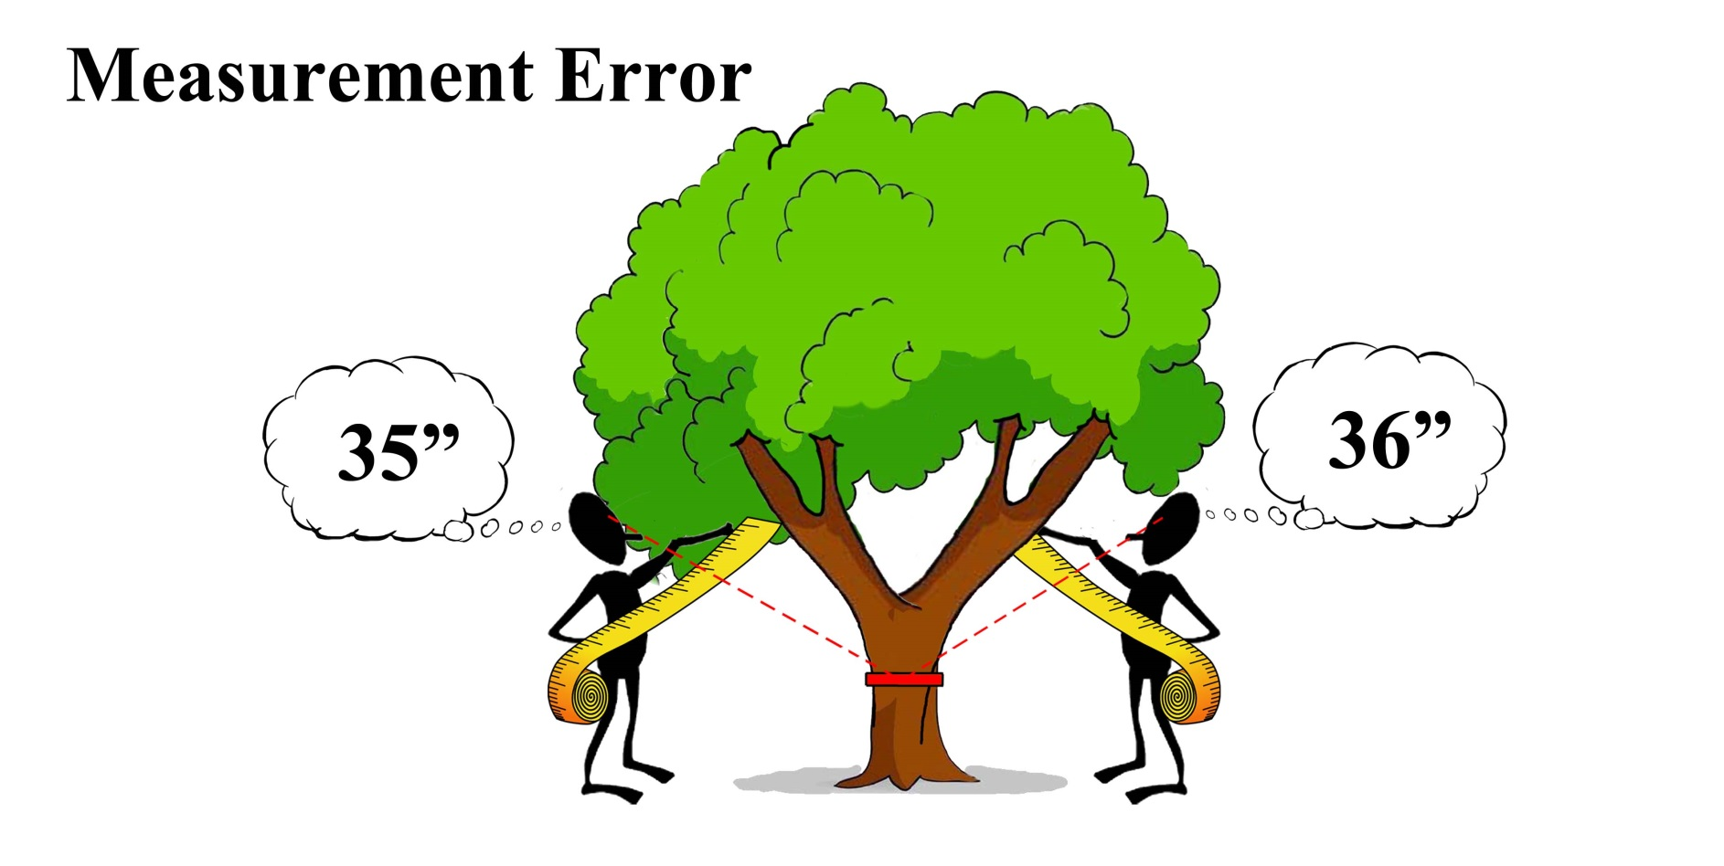
Types of Error

Slide 24
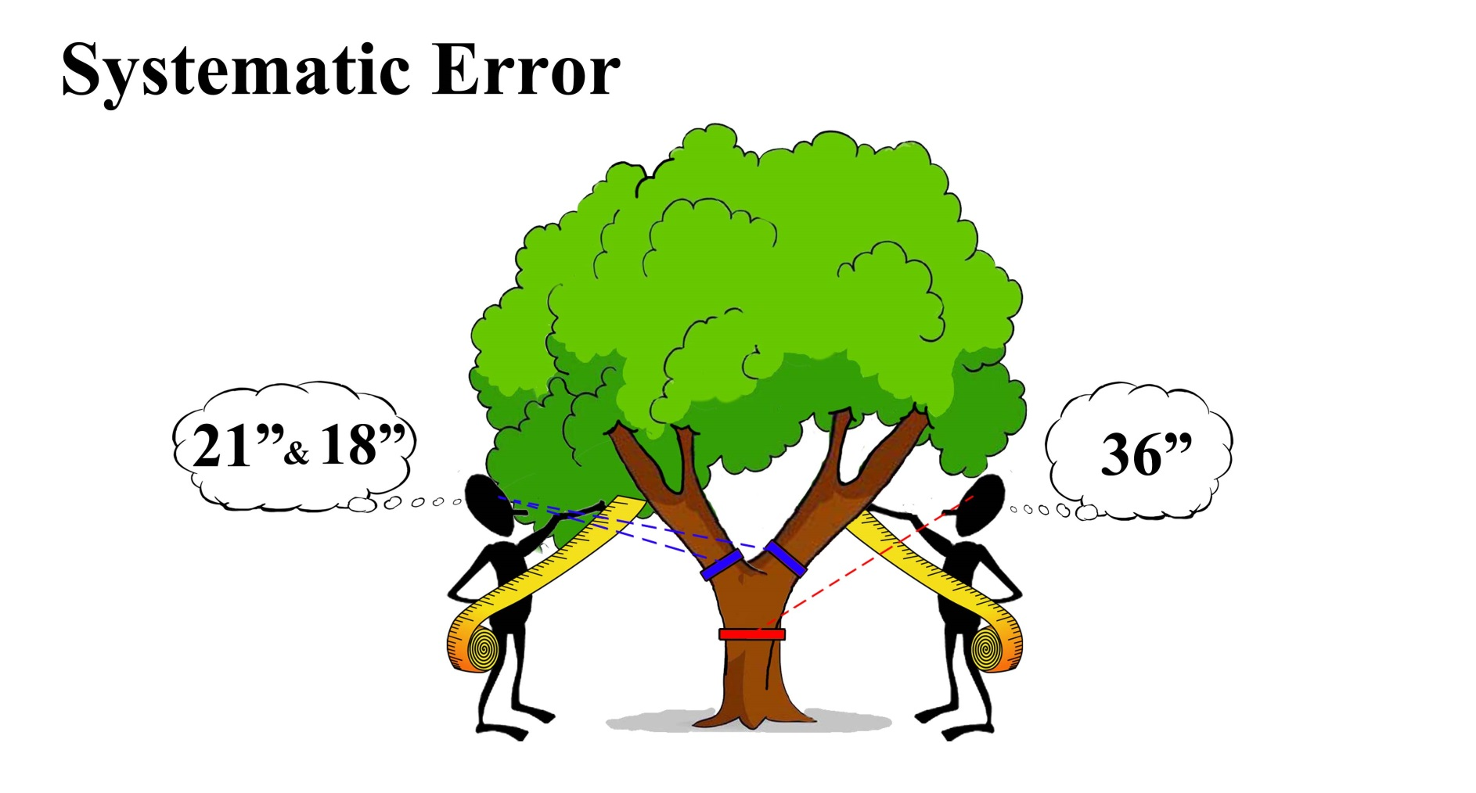
Types of Error

Slide 25
Purpose of this Workshop
Improve precision
Reduce error
Calibrate ratings

Slide 26
Data Collection
First contact
Date and time
Reason for client to call?
Possible conflict of interest?
Phone/email
Assignment
Purpose of the appraisal
Compensation
Level of inspection detail
Limitations
Written Approval by Client

Slide 27
Data Collection
Background on Case
History of situation
Existing documentation
Pertinent information not observable on site
Previously involved consultants
Boundaries and survey

Slide 28
Managing Expectations
“Has the subject tree been appraised before?”
“Did you have a value in mind?”
Politely avoid “red flags”
Disclosure Obligations
The appraisal may or may not be favorable
Discovery by other side, good or bad

Slide 29
Data Collection
Site Inspection
Permission to Enter Property
Time and Date of site visit
Photograph Everything

Slide 30
Data Collection
Recording Tools
Camera
Tape measure/D-Tape
Calipers
Biltmore stick
Sample Collection
Plastic bags
Mason Jars
Soil Auger
Diagnostic Tools
Probe
Mallet
Binoculars
Hand Lens
Shovel/Trowel
Soil moisture meter
Other Tools?

Slide 31
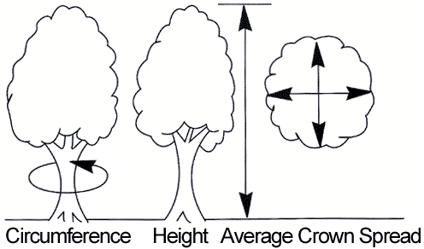
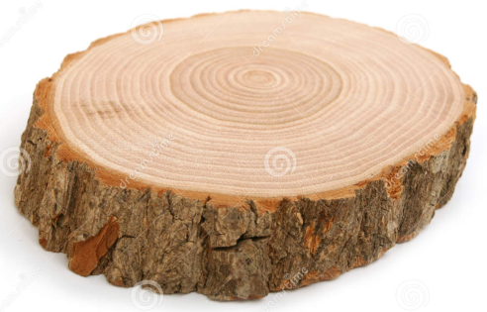
Measuring Tree Size
Tree Height
Canopy Spread
Canopy Volume
Trunk Size
Circumference
Diameter
Cross-sectional area

Slide 32
Measuring Tree Size
Tree Height
Canopy Spread
Canopy Volume
Trunk Size
Circumference
Diameter
Cross-sectional area

Slide 33
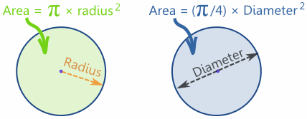
Measuring Tree Size
Cross Sectional Area of a Circle

Slide 34
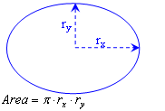
Measuring Tree Size
Cross Sectional Area of an Ellipse

Slide 35
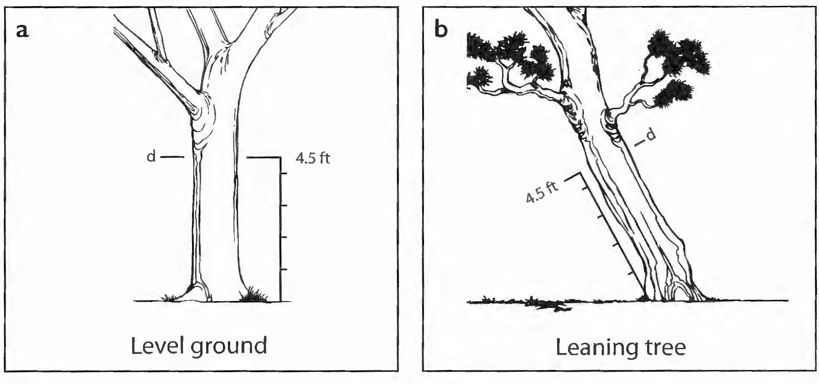
Measuring Tree Size

Slide 36
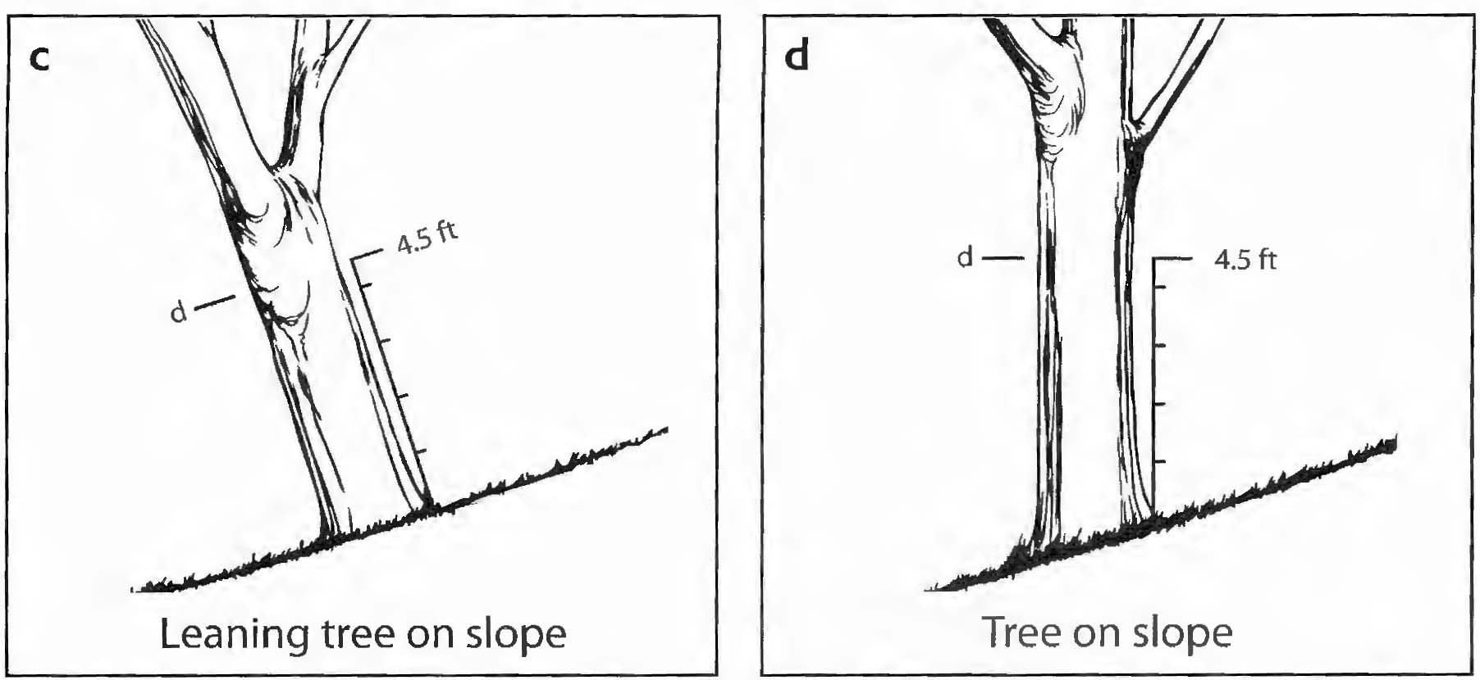
Measuring Tree Size

Slide 37
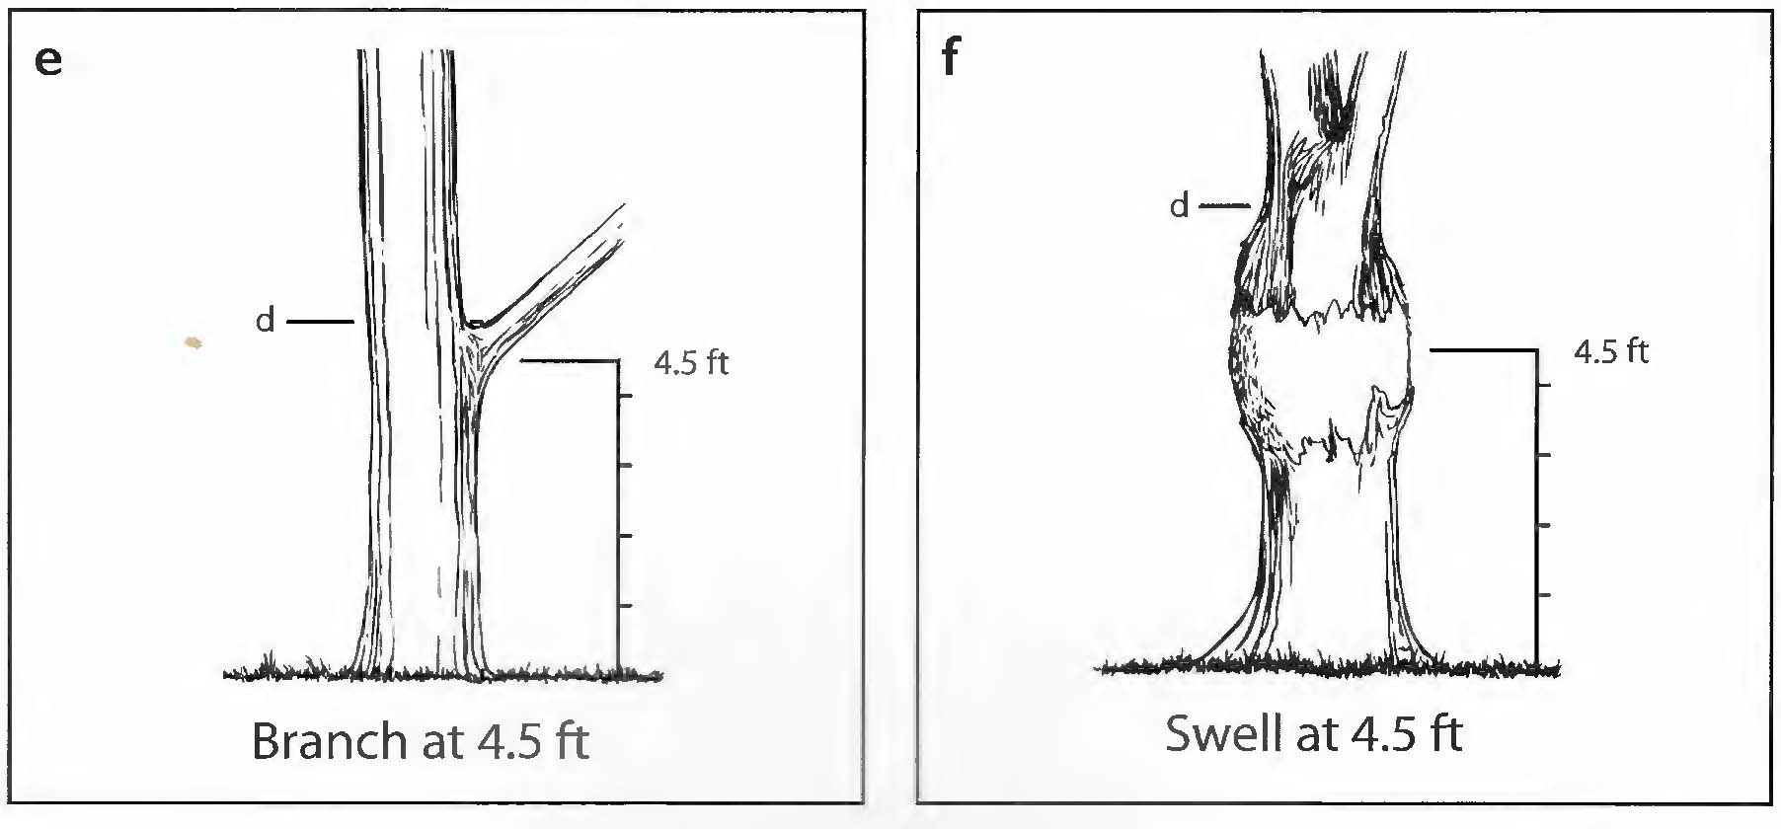
Measuring Tree Size

Slide 38
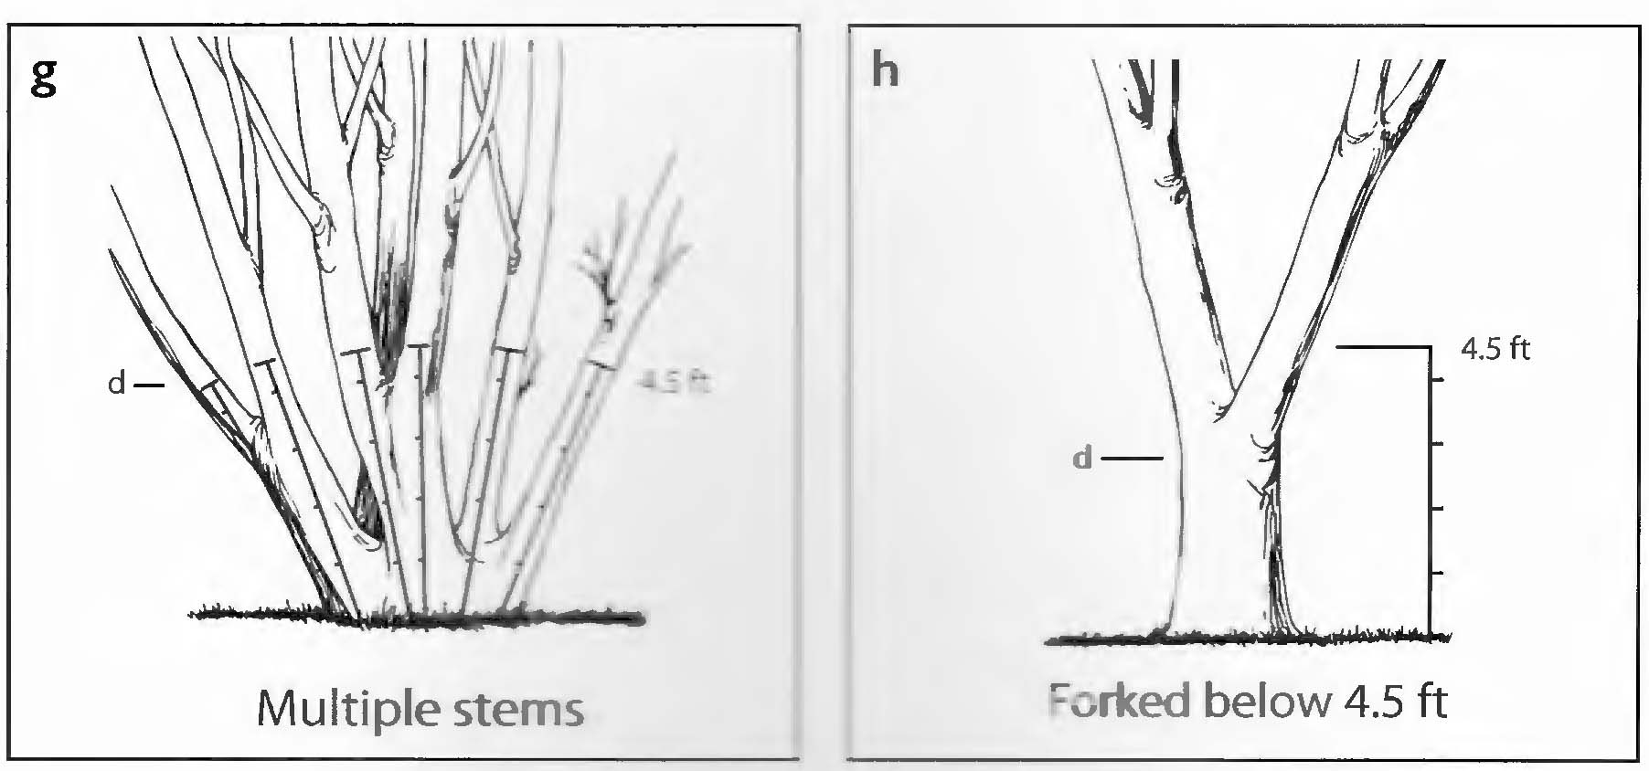
Measuring Tree Size

Slide 39
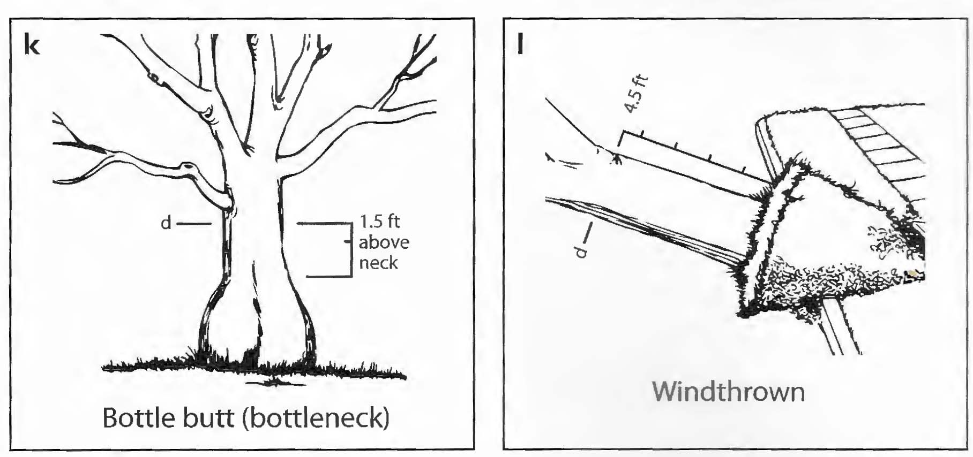
Measuring Tree Size

Slide 40
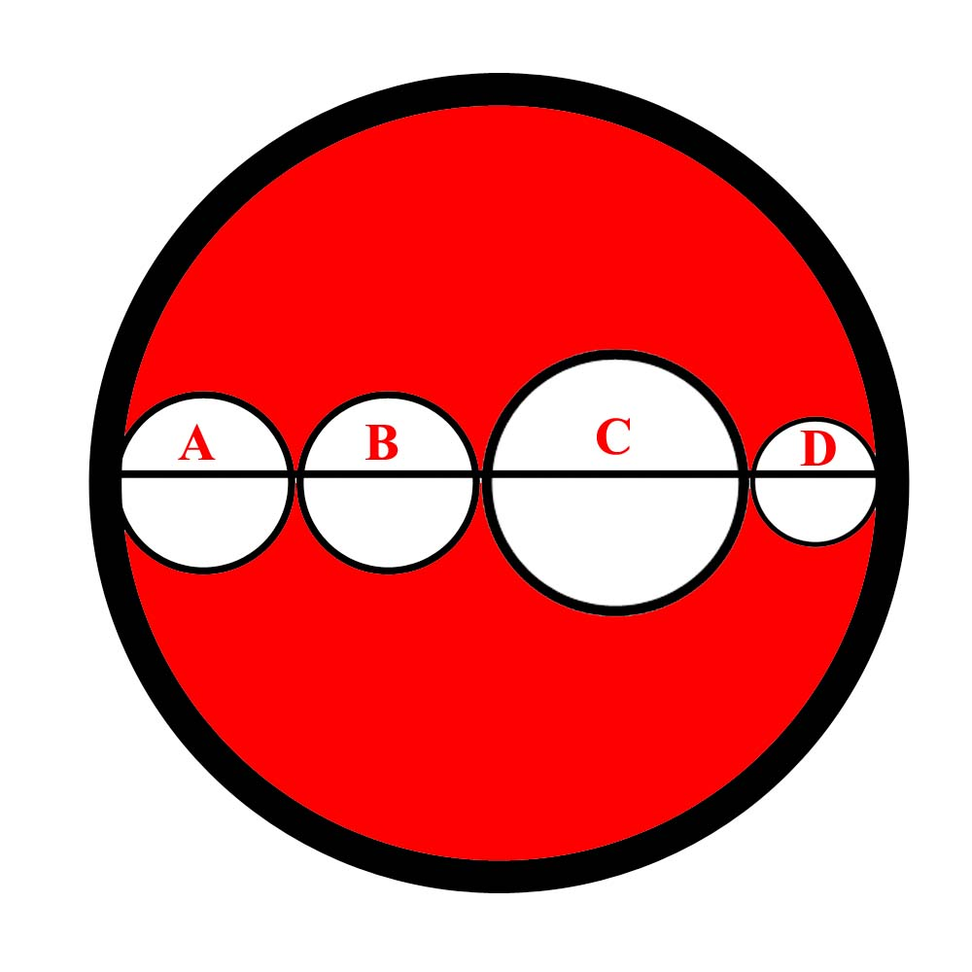
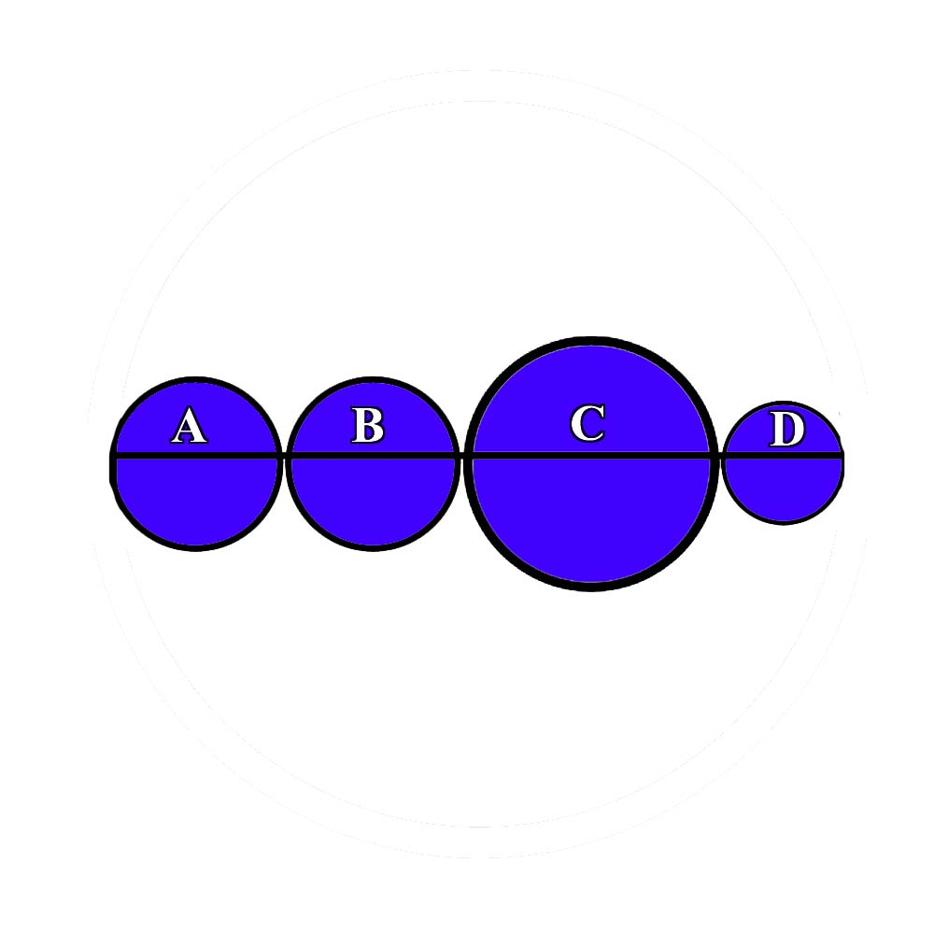
Measuring Tree Size
Wrong
Right

Slide 41
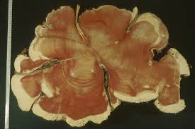
Measuring Tree Size
Limitations
Noncircular trunk

Slide 42
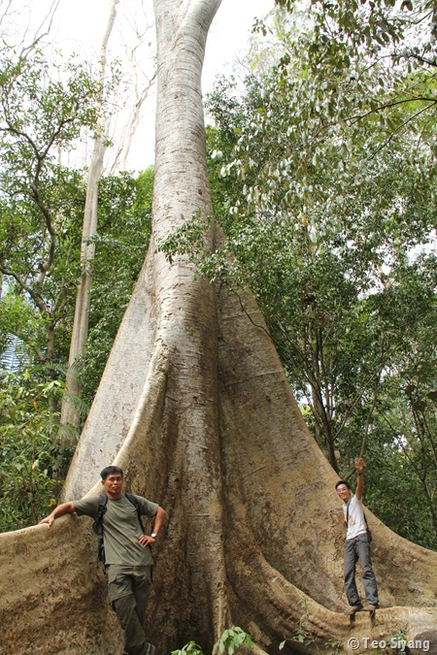
Measuring Tree Size
Limitations
Large abnormalities

Slide 43
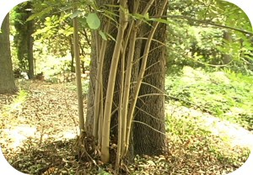
Measuring Tree Size
Limitations
Multi-Trunk vs. Shoots

Slide 44
Unit Cost
Cost per unit Trunk Area of nursery stock ($/in²)
Largest Commonly Available Nursery Tree (LCANT)
Derived from actual nursery data

Slide 45
Unit Cost
Old data (2007)
Installed cost vs. wholesale cost
LCATT vs. LCANT

Slide 46
Unit Cost

Slide 47
Unit Cost

Slide 48
Unit Cost DIY
Contact nurseries
Gather data on prices of LCANT
Gather data on DBH (or cross sectional area)
Calculate the median cost
Calculate the unit cost

Slide 49
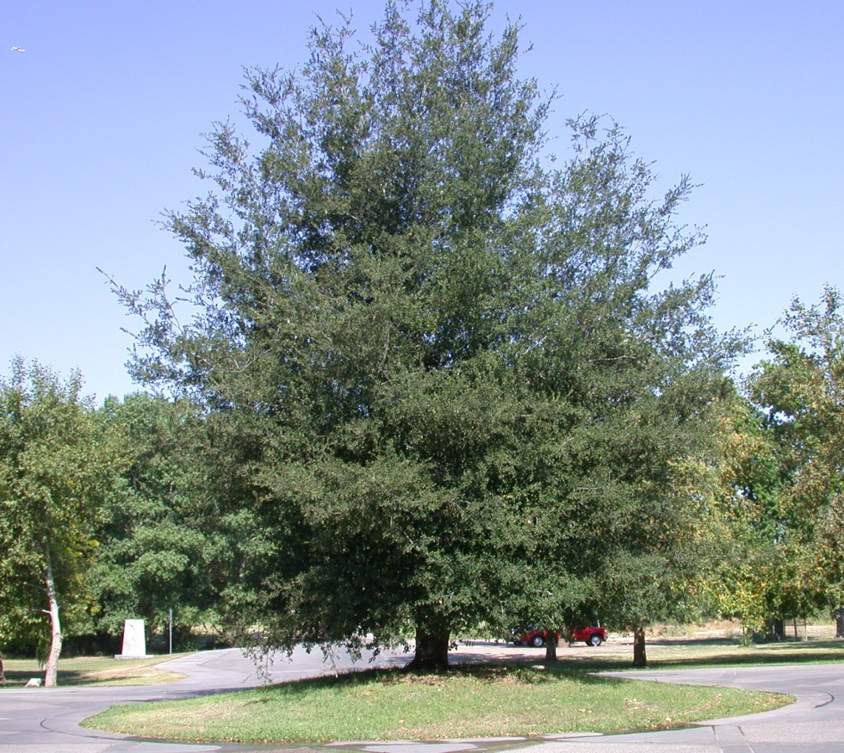
Basic Cost
“Notionally Ideal Tree”
Simplified Calculation
Trunk Area x Unit Cost
Installation cost added later
No Adjusted Trunk Area (ATA)

Slide 50
Depreciation Factors
Depreciation
Fixed Assets lose value over time
Physical Wear and Tear
Functional Obsolescence
Economic Obsolescence
Curable vs. Incurable
Straight-Line Depreciation
Constant loss of value over time
Not Appropriate for trees

Slide 51
Depreciation Factors
Reduce Basic Cost to account for loss of value
Condition Rating
Functional Limitations Rating
External Limitations Rating
Value range from 0-100%

Slide 52
Depreciation Factors
Changes for 10th edition
No species rating
No location rating
Species, location, and ATA incorporated into functional and external limitations ratings

Slide 53
Condition
Health
Structure
Form
Excellent 81%-100%
Good 61%-80%
Fair 41%-60%
Poor 21%-40%
Very Poor 6%-20%
Dead 0%-5%

Slide 54
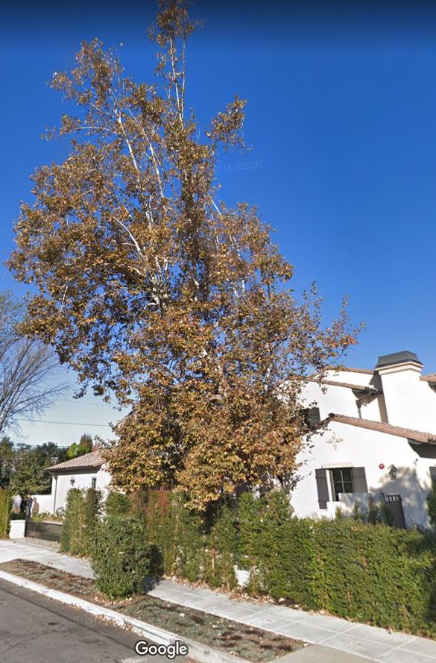
Condition
Health
Structure
Form
Excellent 81%-100%
Good 61%-80%
Fair 41%-60%
Poor 21%-40%
Very Poor 6%-20%
Dead 0%-5%

Slide 55
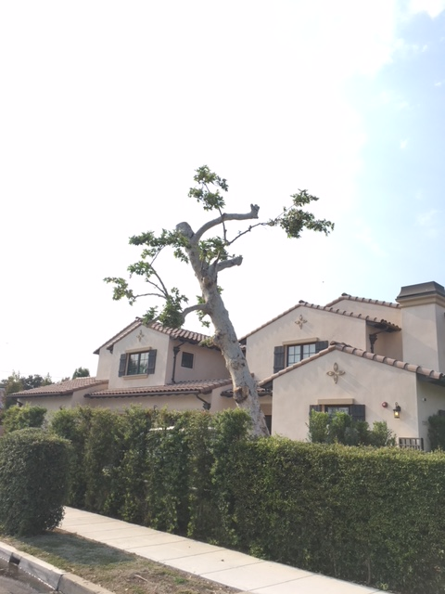
Condition
Health
Structure
Form
Excellent 81%-100%
Good 61%-80%
Fair 41%-60%
Poor 21%-40%
Very Poor 6%-20%
Dead 0%-5%

Slide 56
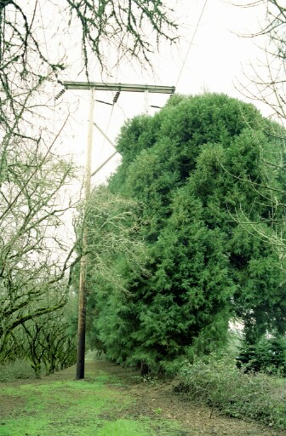
Condition
Health
Structure
Form
Excellent 81%-100%
Good 61%-80%
Fair 41%-60%
Poor 21%-40%
Very Poor 6%-20%
Dead 0%-5%

Slide 57
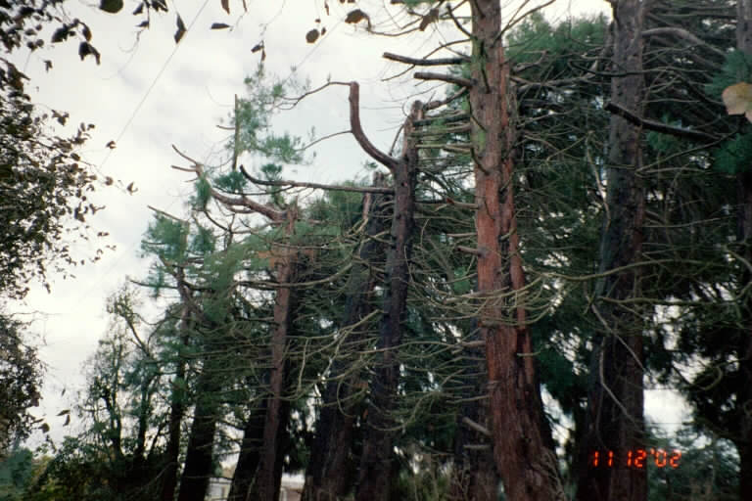
Condition
Health
Structure
Form
Excellent 81%-100%
Good 61%-80%
Fair 41%-60%
Poor 21%-40%
Very Poor 6%-20%
Dead 0%-5%

Slide 58
Condition
Combining Health Structure, and Form
Lowest Rating
Mean Value
Weighted Average
Intuitive

Slide 59
Functional Limitations
Interaction of species and site
How effective it is at performing its function

Slide 60
Functional Limitations
Allergenic properties
Light/glare shield
Shade and cooling
Safety barrier
Wind control
Traffic control
Erosion control
Cleanliness of flowers, leaves, and fruit

Slide 61
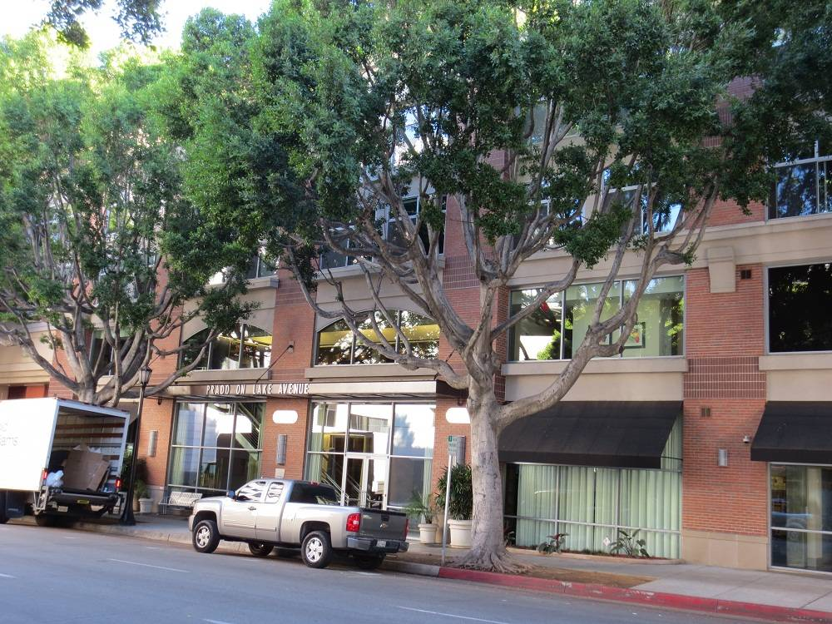
Functional Limitations

Slide 62
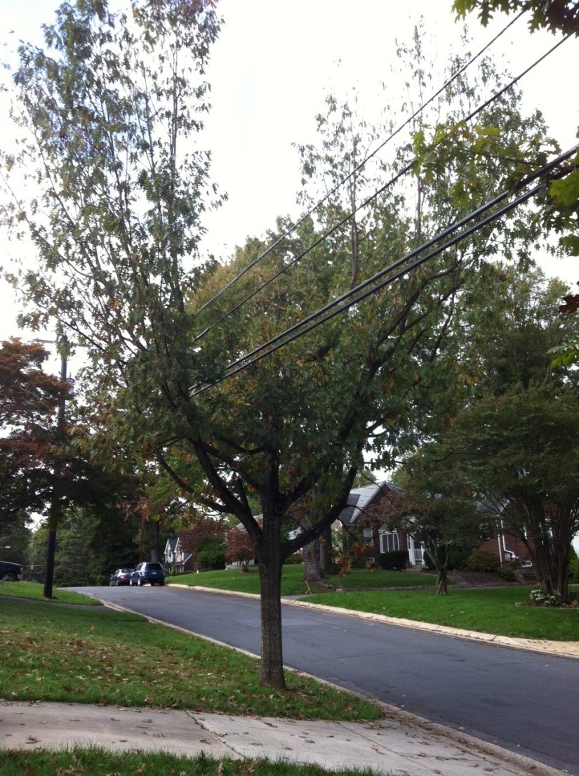
Functional Limitations

Slide 63
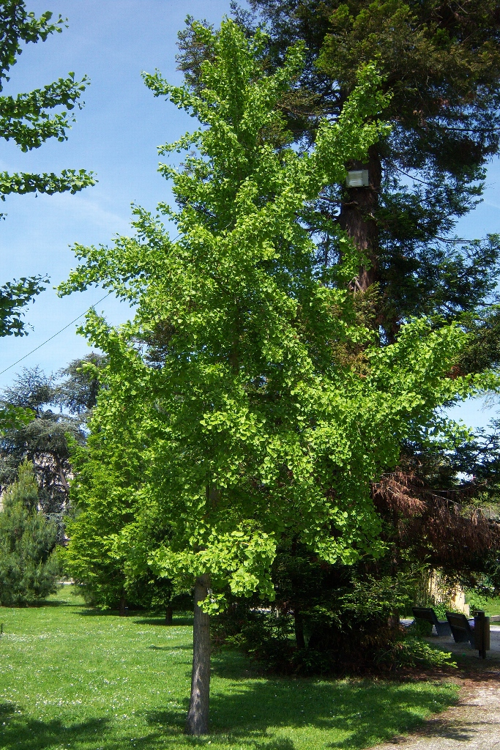
Functional Limitations

Slide 64
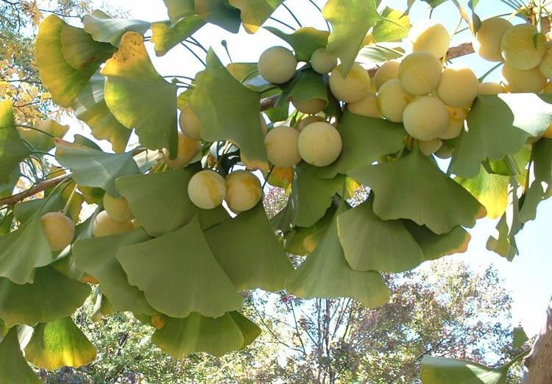
Functional Limitations

Slide 65
External Limitations
Factors outside of the property
Out of control of property owner
Affect plant condition

Slide 66
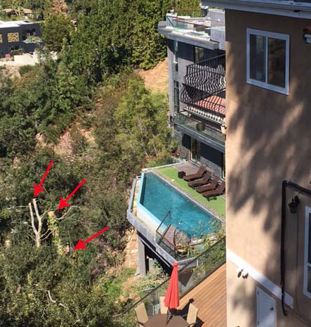
External Limitations
View Ordinances or CCRs

Slide 67
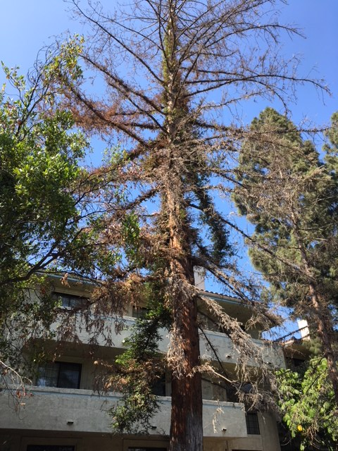
External Limitations
View Ordinances or CCRs
Water use restrictions

Slide 68
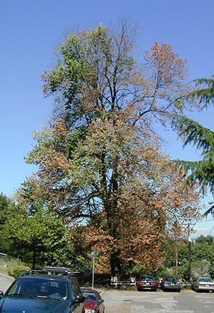
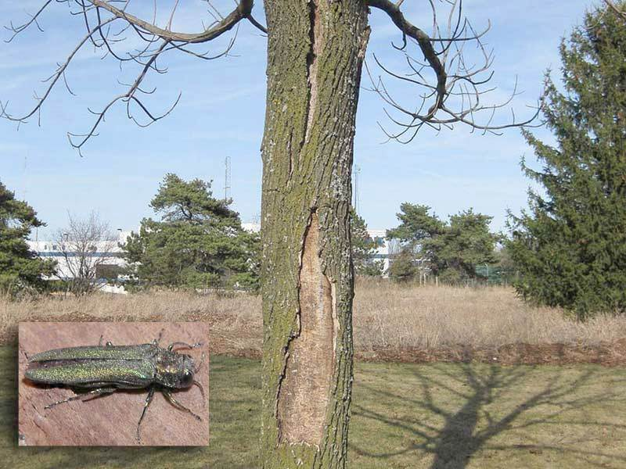
External Limitations
View Ordinances or CCRs
Water use restrictions
Presence of Serious Pests

Slide 69
Final Calculation
Basic Cost x
Condition Rating x
Functional Limitations Rating x
External Limitations Rating
= Depreciated Cost

Slide 70
Final Calculation
Additional Costs
Installation
Stump Removal
Post-Planting Monitoring
Collateral Repairs

Slide 71
Final Calculation
Rounding
2-3 significant figures
Implies level of precision
$8,874.42 rounds to:
$9,000.00 one significant figure
$8,900.00 two significant figures
$8,870.00 three significant figures
$8,874.00 four significant figures

Slide 72
Reconciliation
Test of Reasonableness
Use multiple appraisal methods and/or approaches
Reject outliers
Support chosen method with evidence
Defensible conclusion

Slide 73
Classroom Practice
Tree Measurement
Where to place the tape
Case studies
Not always a “correct” answer

Slide 74
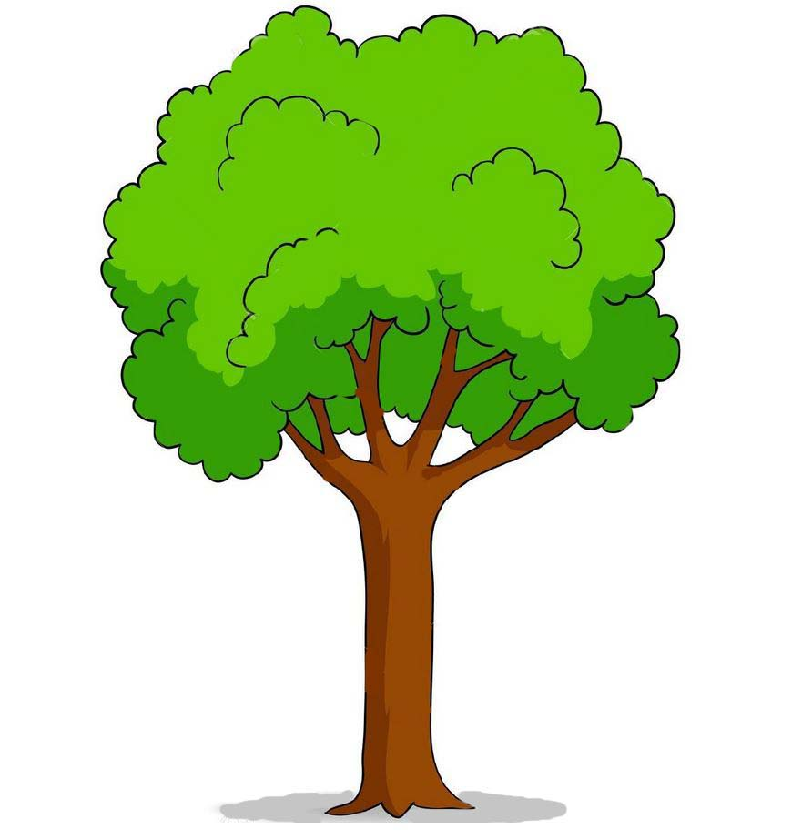
Classroom Practice
Where do we measure it?

Slide 75
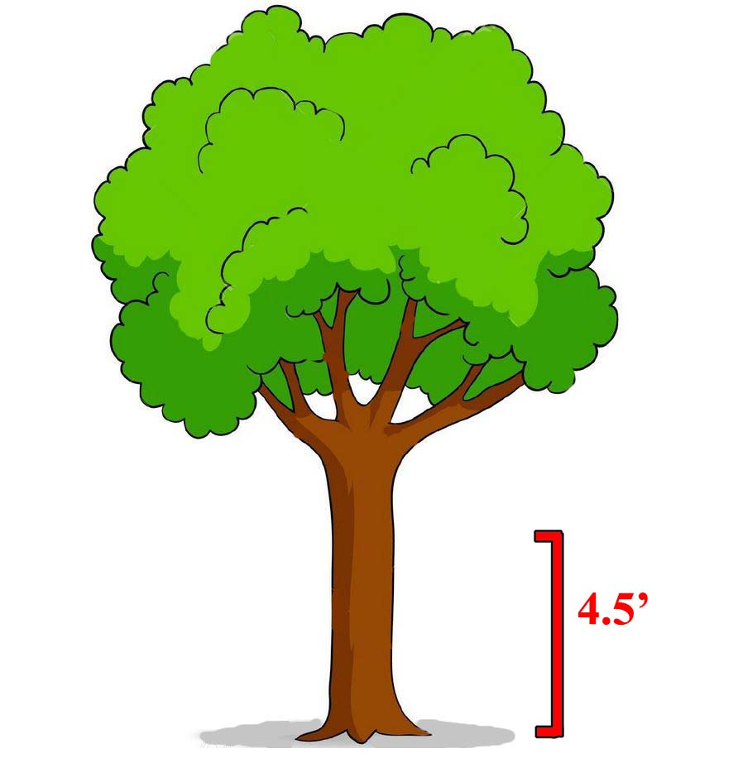
Classroom Practice
Where do we measure it?

Slide 76
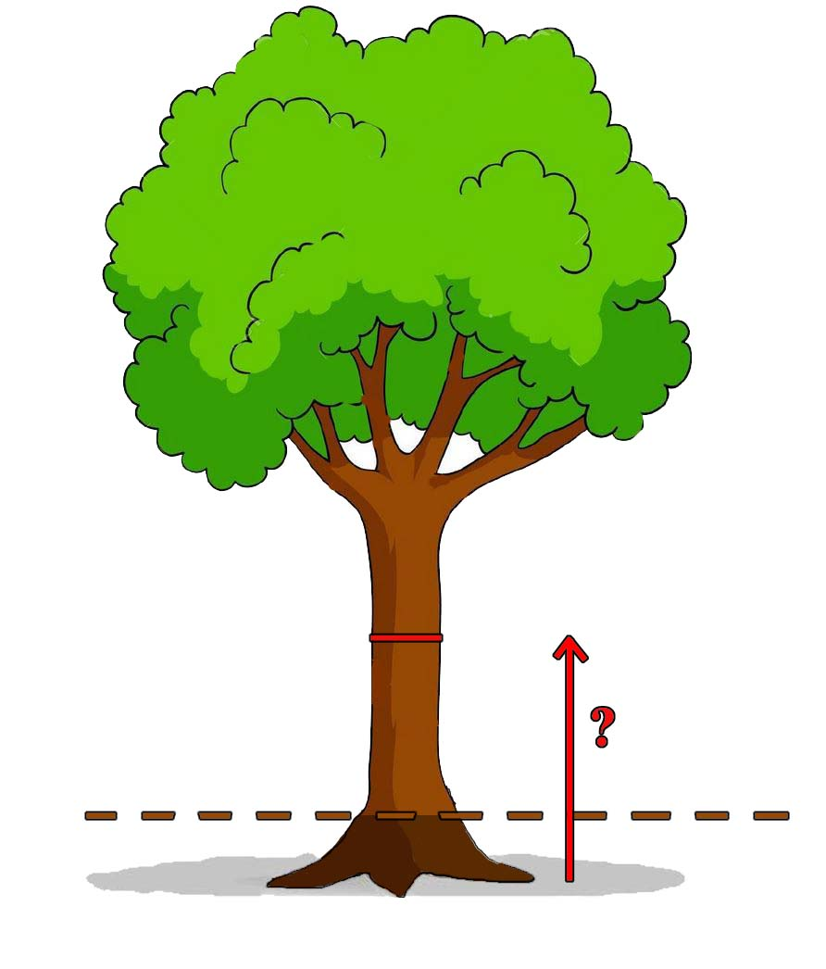
Classroom Practice
Grade lowered

Slide 77
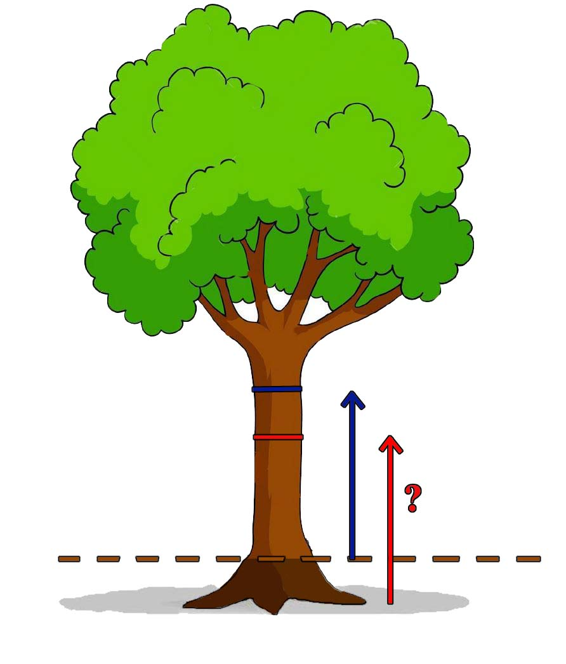
Classroom Practice
Use Natural Grade

Slide 78
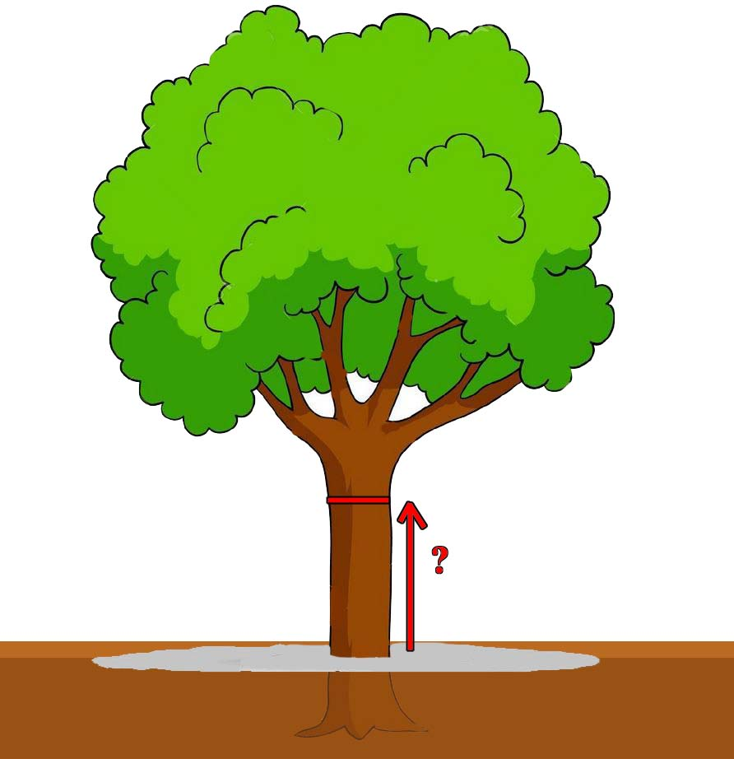
Classroom Practice
Fill soil added

Slide 79
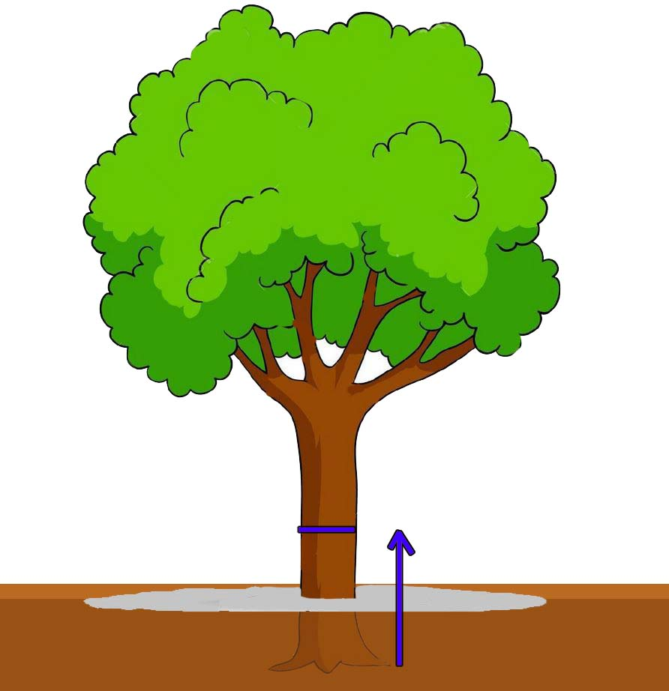
Classroom Practice
Use natural grade

Slide 80
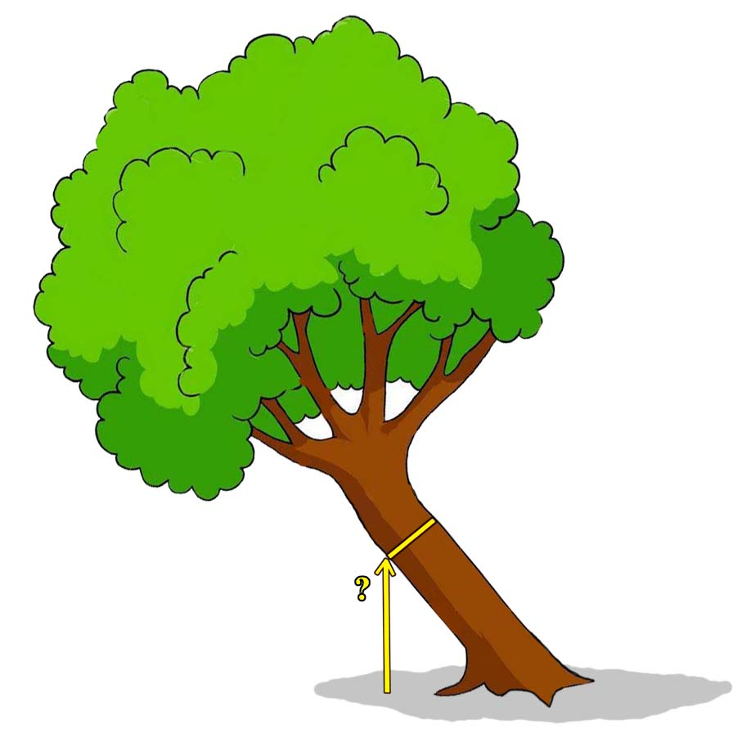
Classroom Practice
Where do we measure it?

Slide 81
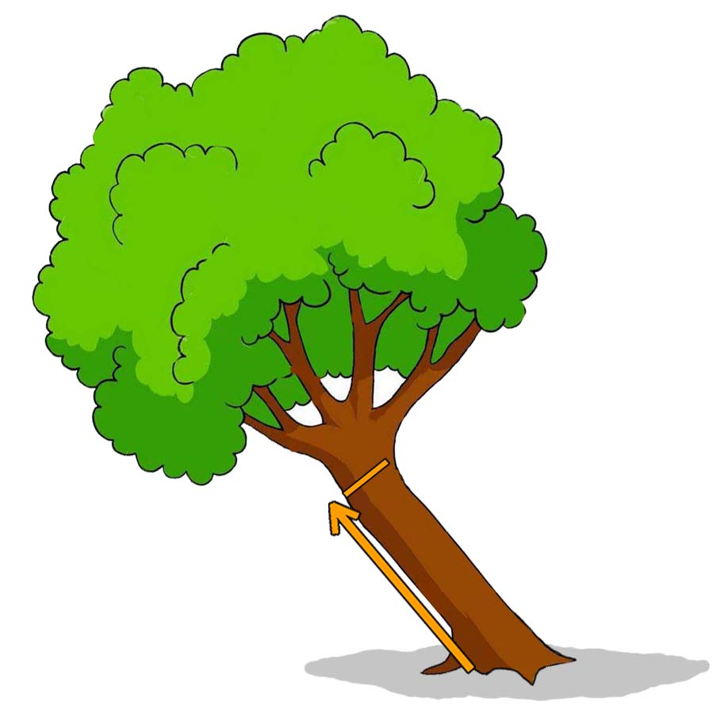
Classroom Practice
Where do we measure it?

Slide 82
Classroom Practice
Steep slope

Slide 83
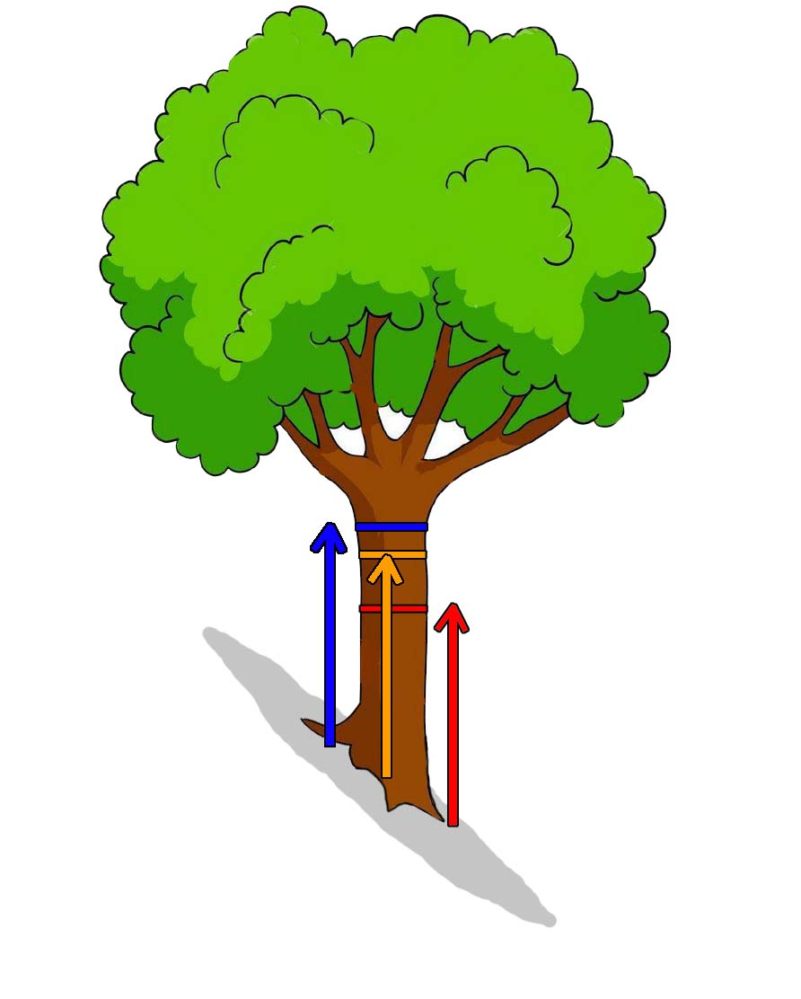
Classroom Practice
Steep Slope

Slide 84
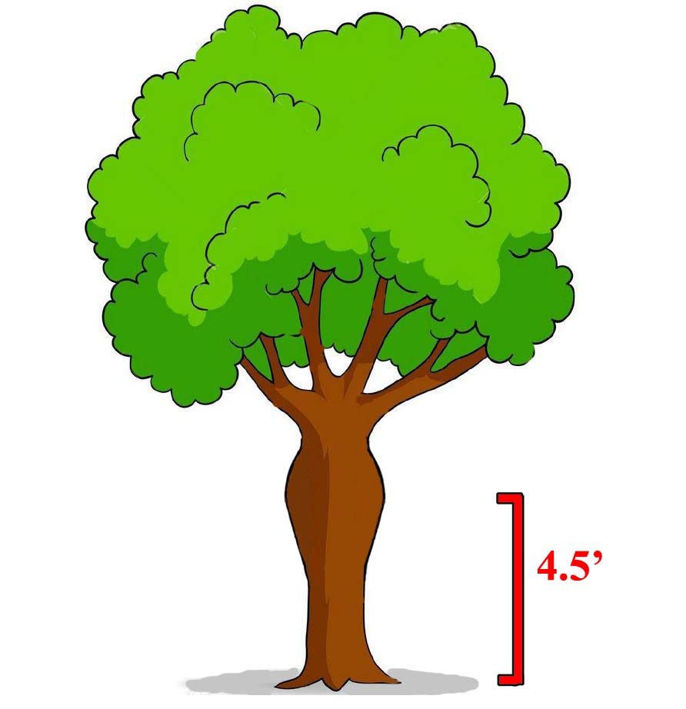
Classroom Practice
Trunk abnormality

Slide 85
Classroom Practice
Height that “best represents the size of the tree”

Slide 86
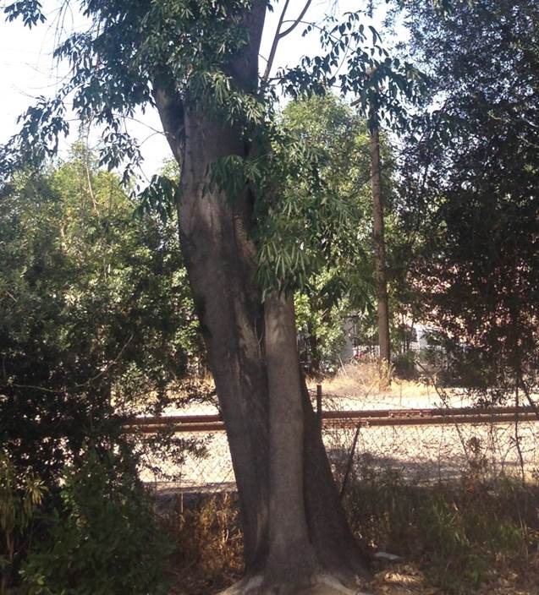
Classroom Practice
Where do we measure it?

Slide 87
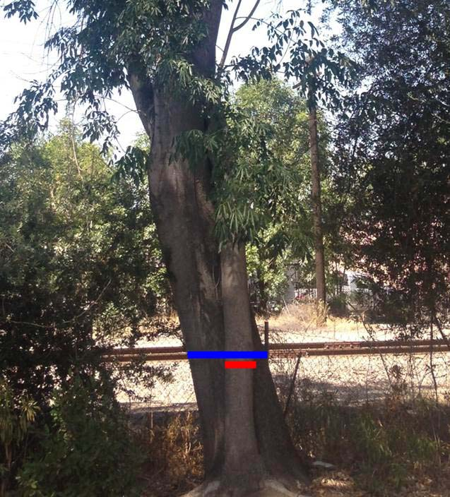
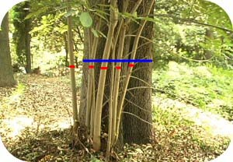
Classroom Practice
When is it a shoot?
When is it a trunk?

Slide 88
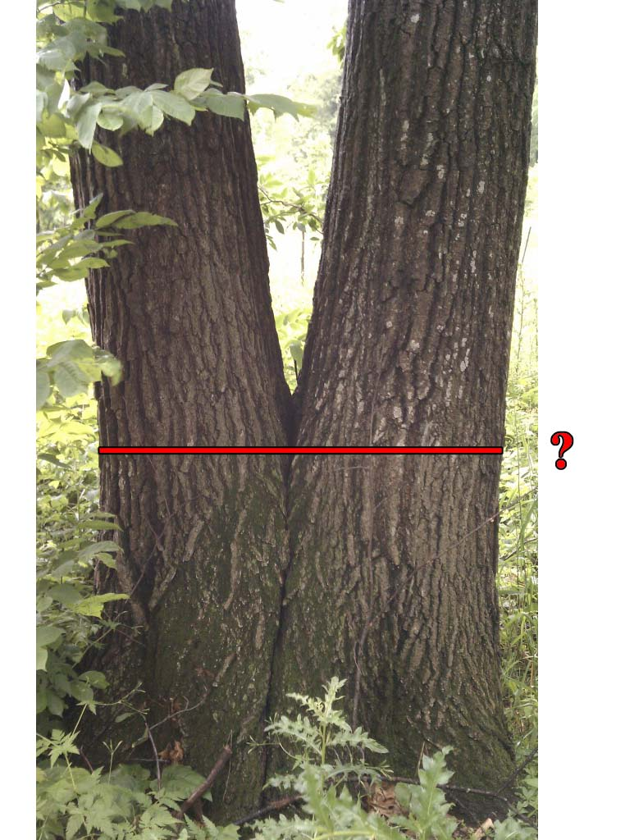
Classroom Practice
Where do we measure it?

Slide 89
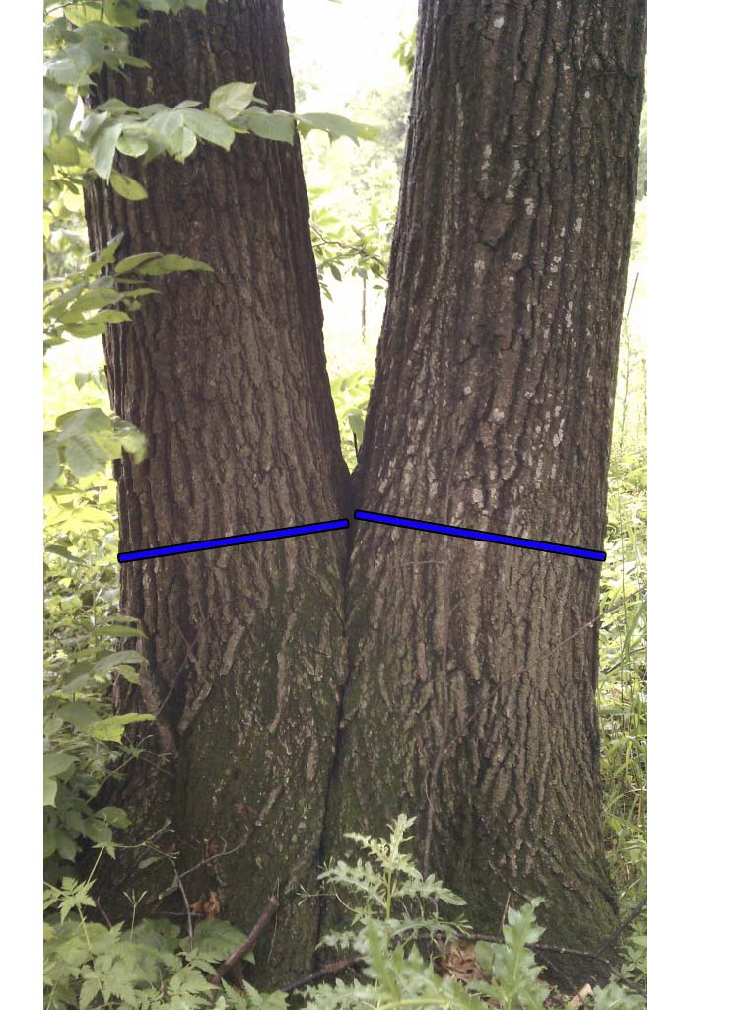
Classroom Practice
Where do we measure it?

Slide 90
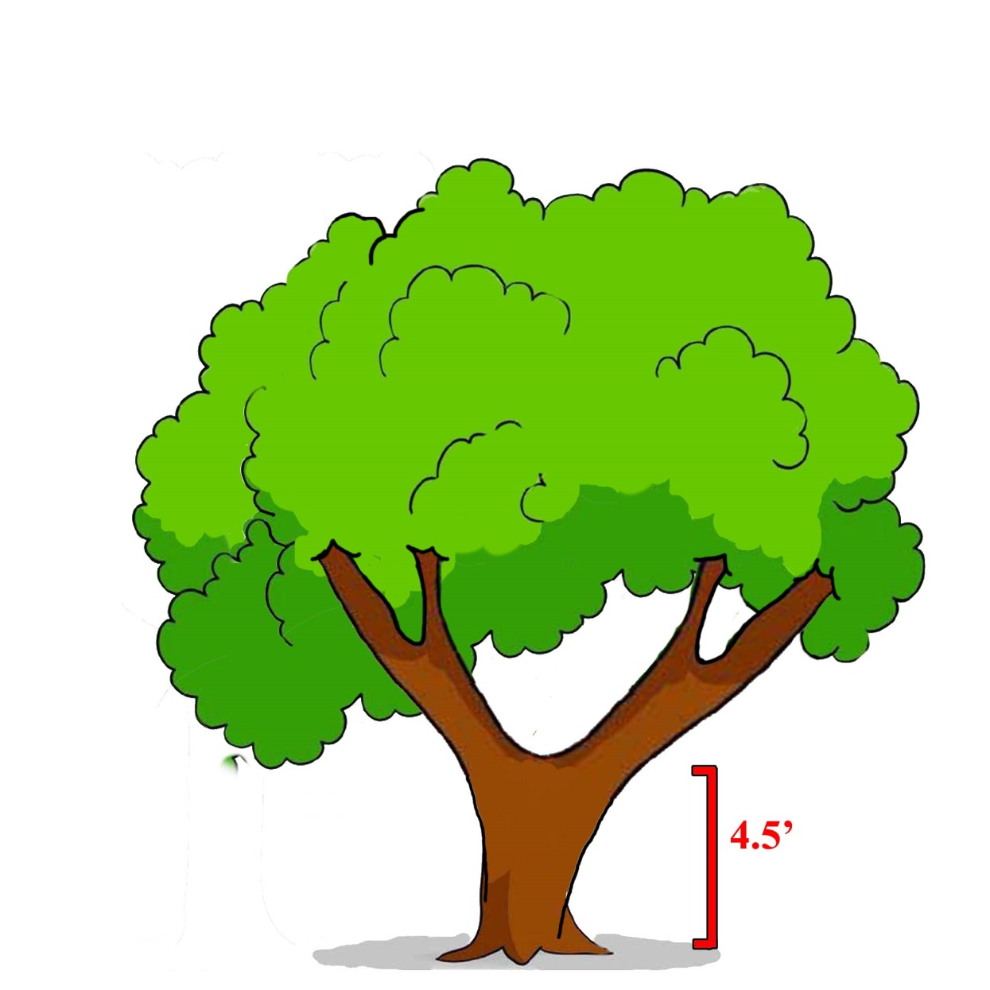
Classroom Practice
Where do we measure it?

Slide 91
Classroom Practice
Where do we measure it?

Slide 92
Classroom Practice
Where do we measure it?

Slide 93
Classroom Practice
Where do we measure it?

Slide 94
Classroom Practice
Where do we measure it?

Slide 95
Classroom Practice
Classroom Appraisal Sheet
Redwood growing on college campus in the San Francisco Bay Area, near a library.

Slide 96
Field Appraisal
Tree 1
Cercidiphyllum japonicum
#4 Unit Tree Cost: $72
#13 Installation: $306

Slide 97
Field Appraisal
Tree 2
Cedrus libani
#4 Unit Tree Cost: $57
#13 Installation: $241

Slide 98
Field Appraisal
Tree 3
Tilia cordata
#4 Unit Tree Cost: $72
#13 Installation: $306

Slide 99
Field Appraisal
Tree 4
Pinus strobus
#4 Unit Tree Cost: $57
#13 Installation: $241

Slide 100
Field Appraisal
Tree 5
Quercus bicolor
#4 Unit Tree Cost: $72
#13 Installation: $306

Slide 101
Conclusion
What have we learned?

Slide 102
Conclusion
What have we learned?
Personal evaluation vs. personal value error
Practice ethics
Trunk Formula Technique is only a small part of tree appraisal

Slide 103
Conclusion
Summary of Changes from 9th to 10th Edition (TFT)
New depreciation ratings
No Species Rating
No Adjusted Trunk Area (ATA)
Unit cost from LCATT to LCANT
Unit cost includes wholesale, not retail or installed cost
More flexibility with condition rating
More flexibility with rounding

Slide 104
Final Thoughts
Defensible conclusion
Keep records of everything
Appraise with ethics

Slide 105
Basic Tree Appraisal
Focusing on the Trunk Formula Technique
Terrence P. Flanagan
BCMA #PN-0120BMTL
James Komen
BCMA #WE-9909B
RCA #555
March 7, 2019

